Slide 1
Species-Sound Associations

Slide 2
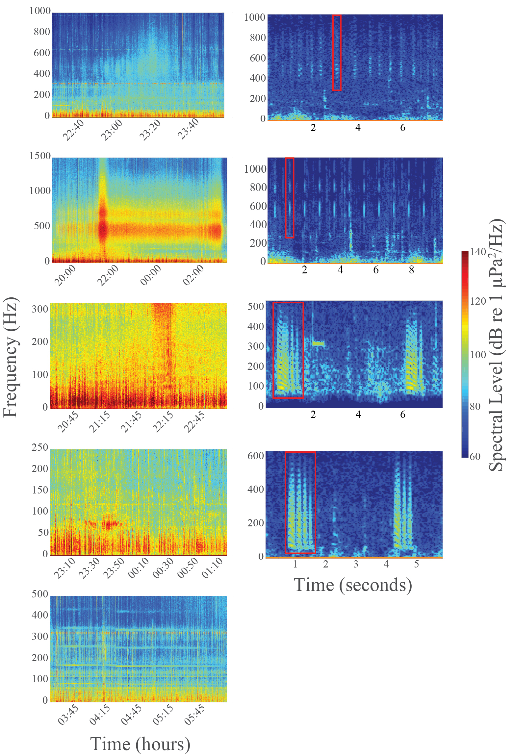


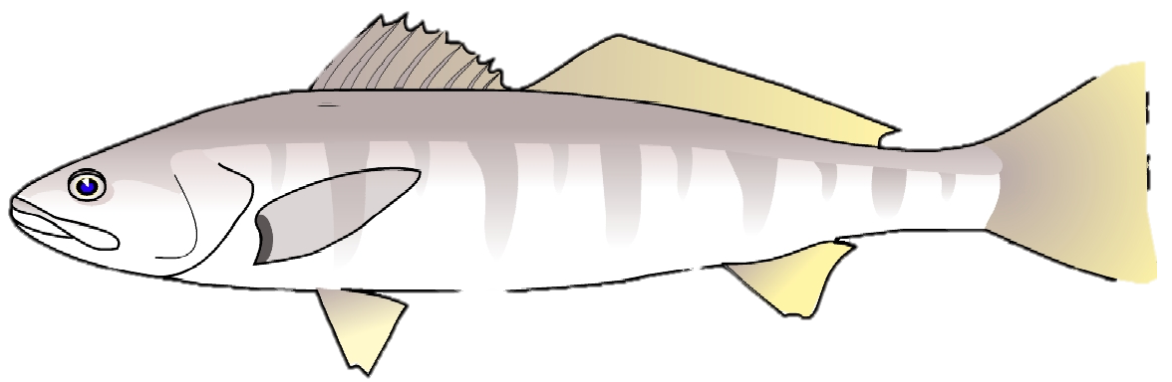
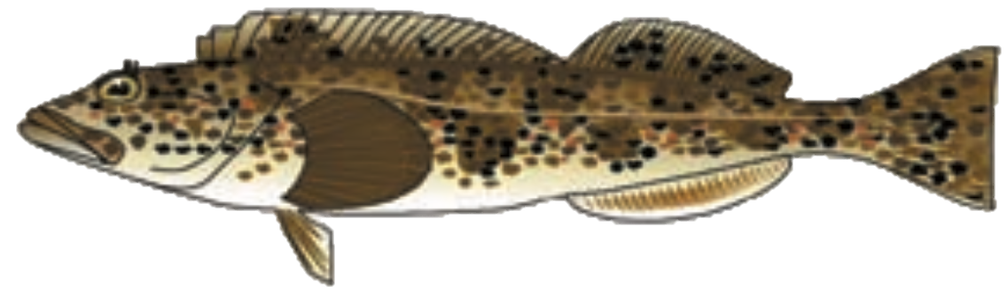
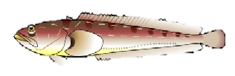
Chorus
Individual Call
I
Queenfish
?
II
White Seabass
III
Latitude
Spectral Density (dB re 1 𝜇Pa²/Hz)
?
Lingcod
IV
V
Longitude
Plainfin Midshipmen

